Slide 1
md2pptx Markdown To Powerpoint Converter 2.5.3+ 2 March, 2022 Presentation built: 21:06 on 2 March, 2022
template | Martin Template.pptx

Slide 2
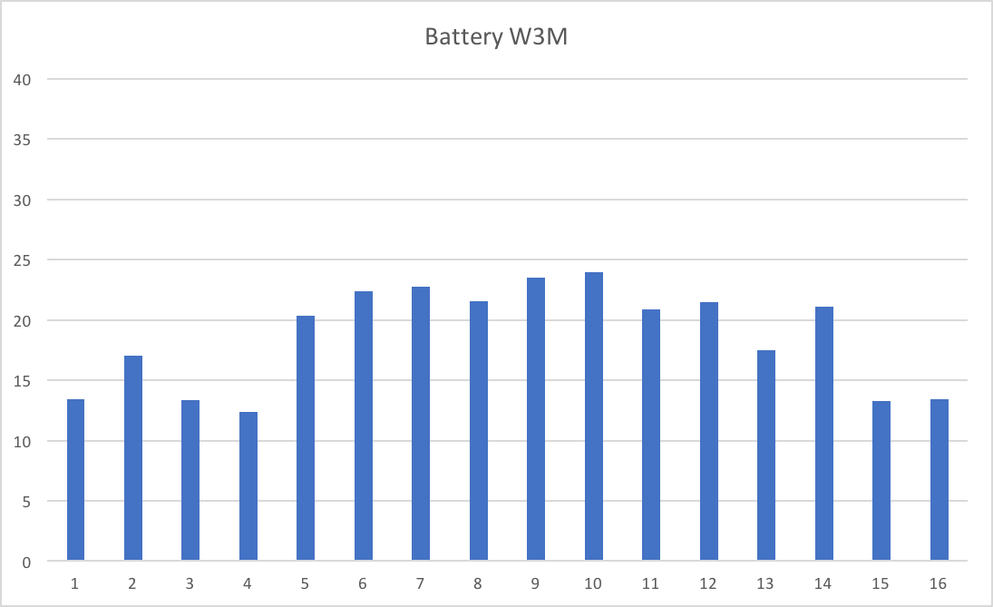
Test Heading

